Slide 1
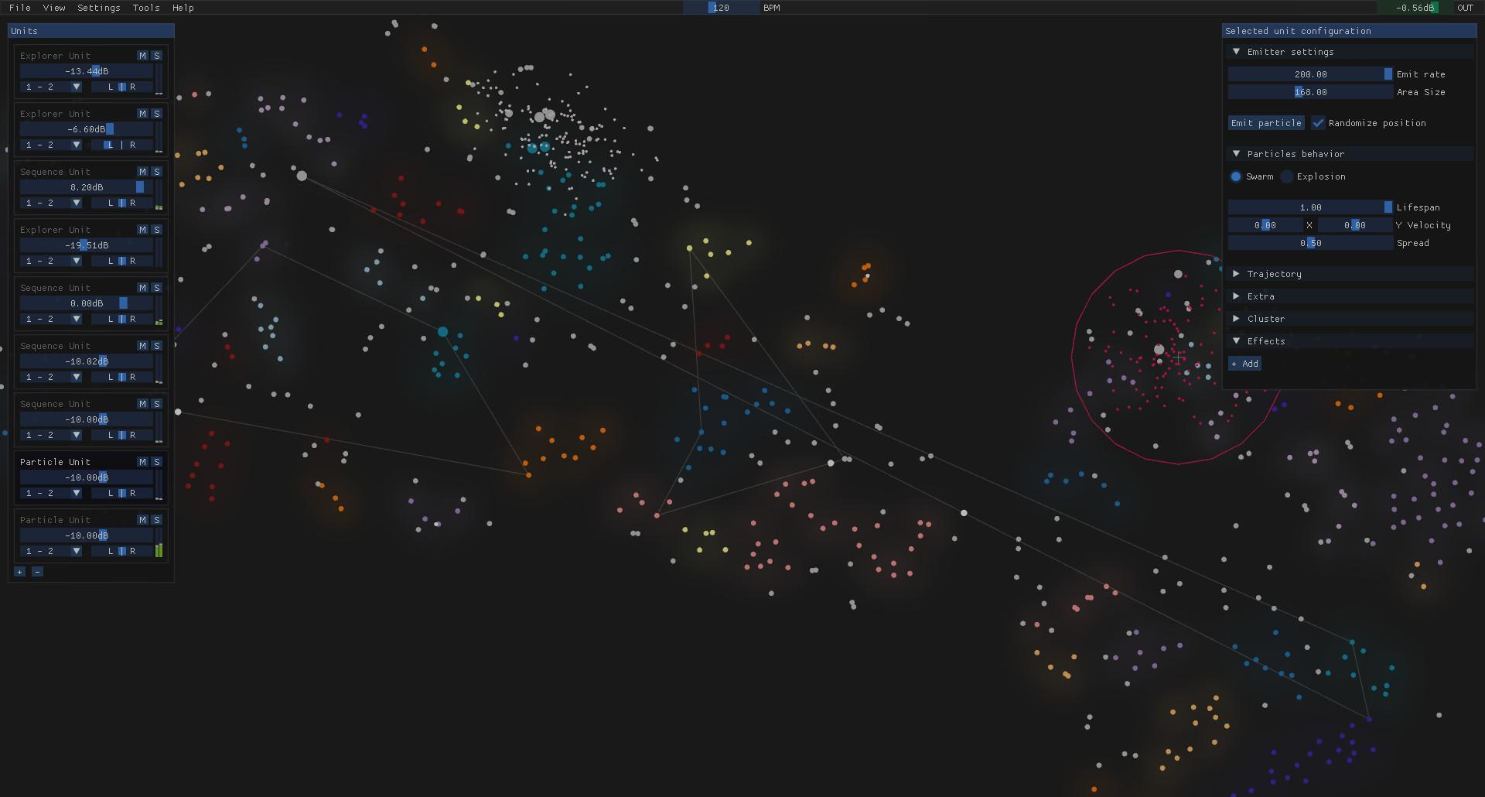
AudioStellar
Sampler experimental potenciado por IA

Slide 2
¿Cómo suenan las regiones vacias en AudioStellar?

Slide 3
Crossfade de Volumen
Interpolacion Espectral
Machine Learning

Slide 4
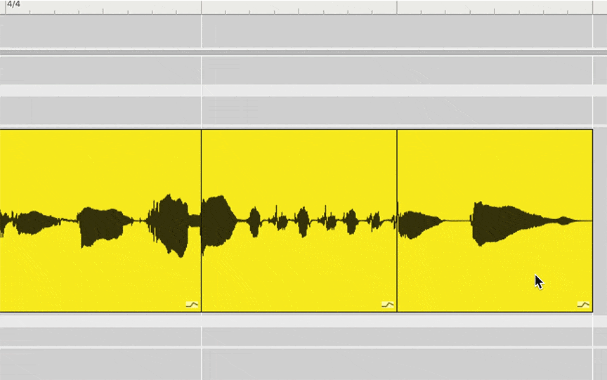

Slide 6
Miller, Darren. (2015). Compositional Outcomes of Audio Morphing Research.

Slide 7
Morph Unit

Slide 8
Machine Learning

Slide 9
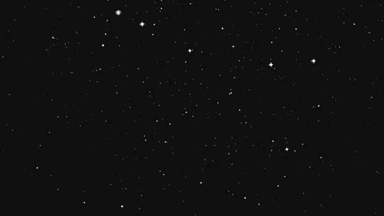
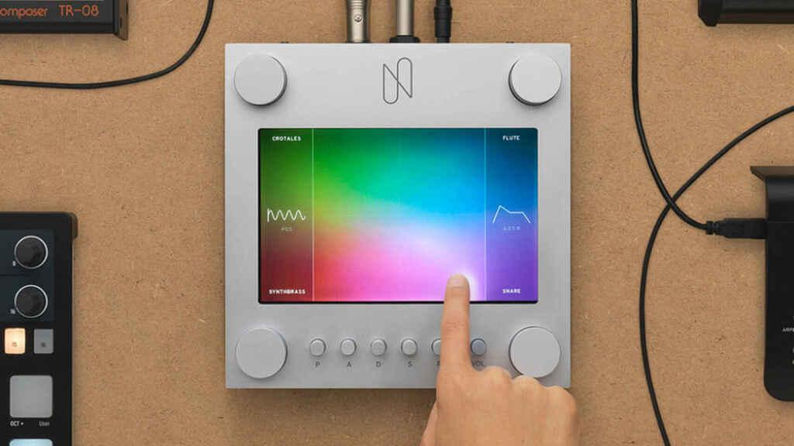
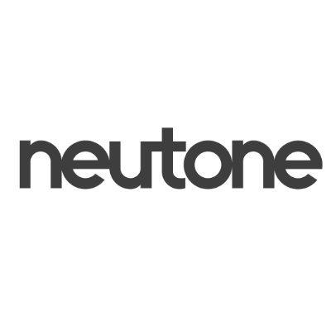
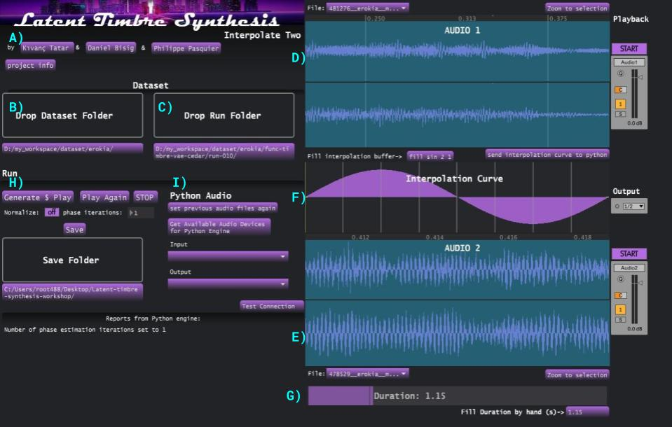
Google Magenta - NSynth
Machine Learning

Slide 10
Google Magenta - NSynth
Links
Rave
https://github.com/acids-ircam/RAVE
https://github.com/acids-ircam/nn_tilde
https://github.com/acids-ircam/rave_vst
https://caillonantoine.github.io/ravejs/
https://www.youtube.com/watch?v=W2PuTlFQL8U
https://twitter.com/piesaac/status/1531724435928911872
https://www.youtube.com/watch?v=dMZs04TzxUI
https://www.youtube.com/watch?v=3l368jotGAo
DDSP
https://magenta.tensorflow.org/ddsp-vst
https://www.youtube.com/watch?v=ZgMpo3uGvIk
NSynth
https://www.youtube.com/watch?v=0fjopD87pyw
GanHarp
https://ganharp.ctpt.co/
MelSpecVae
https://github.com/moiseshorta/MelSpecVAE
Neutone
https://neutone.space/

